Slide 1
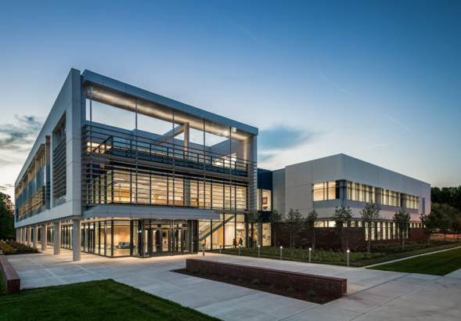
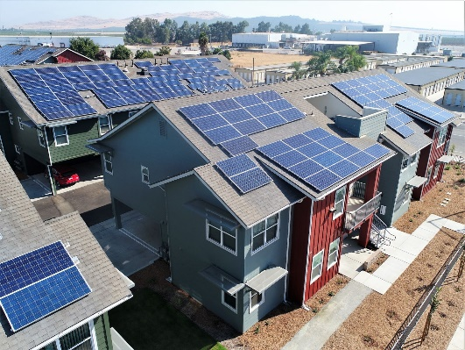
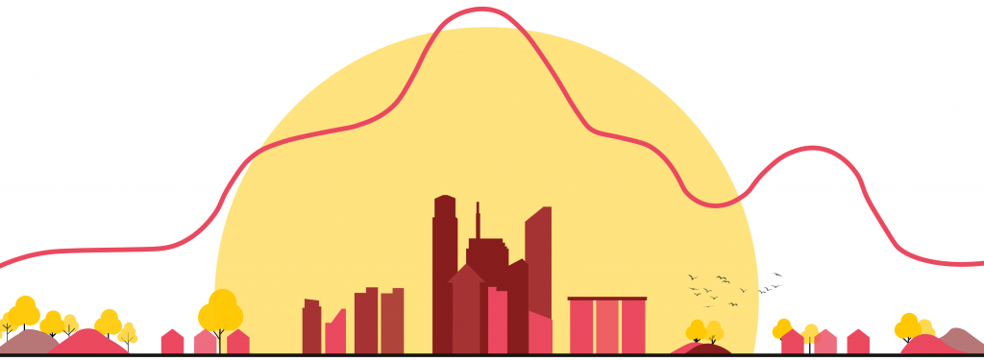
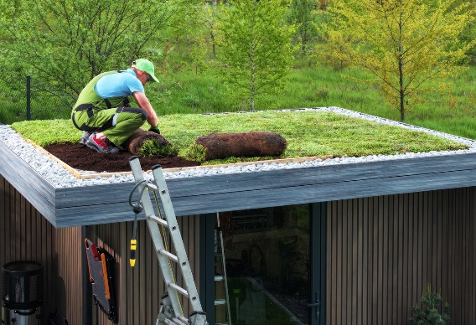
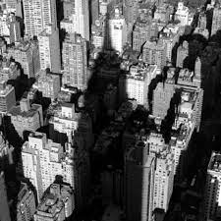

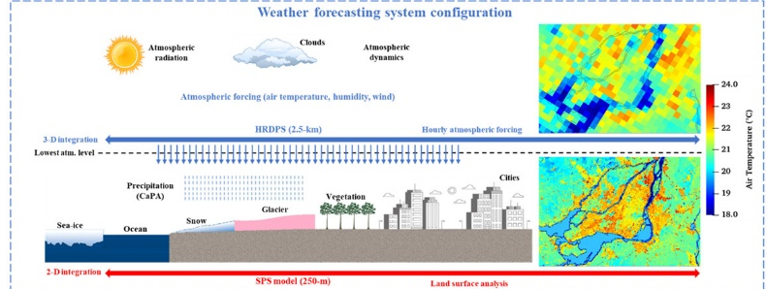
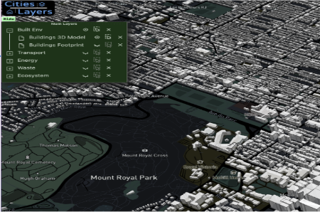
Bottom-up building energy prediction
Urban rooftop PV retrofitting
Data exchange with microclimate models
CityBEM
Urban green roof retrofitting
Developed in
Inter-building shading impacts
Data exchange with weather forecasting models
Integrated with other UBEMs like tools4cities

Slide 2
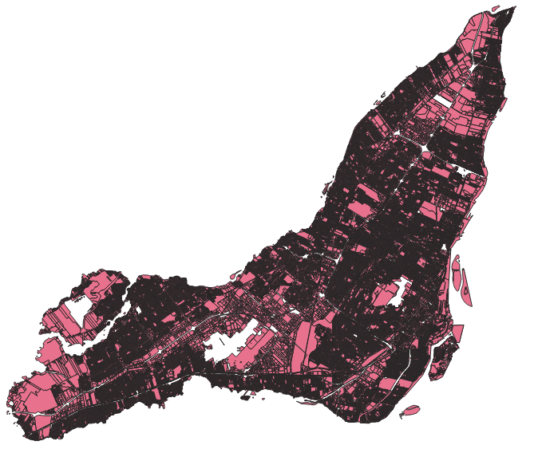
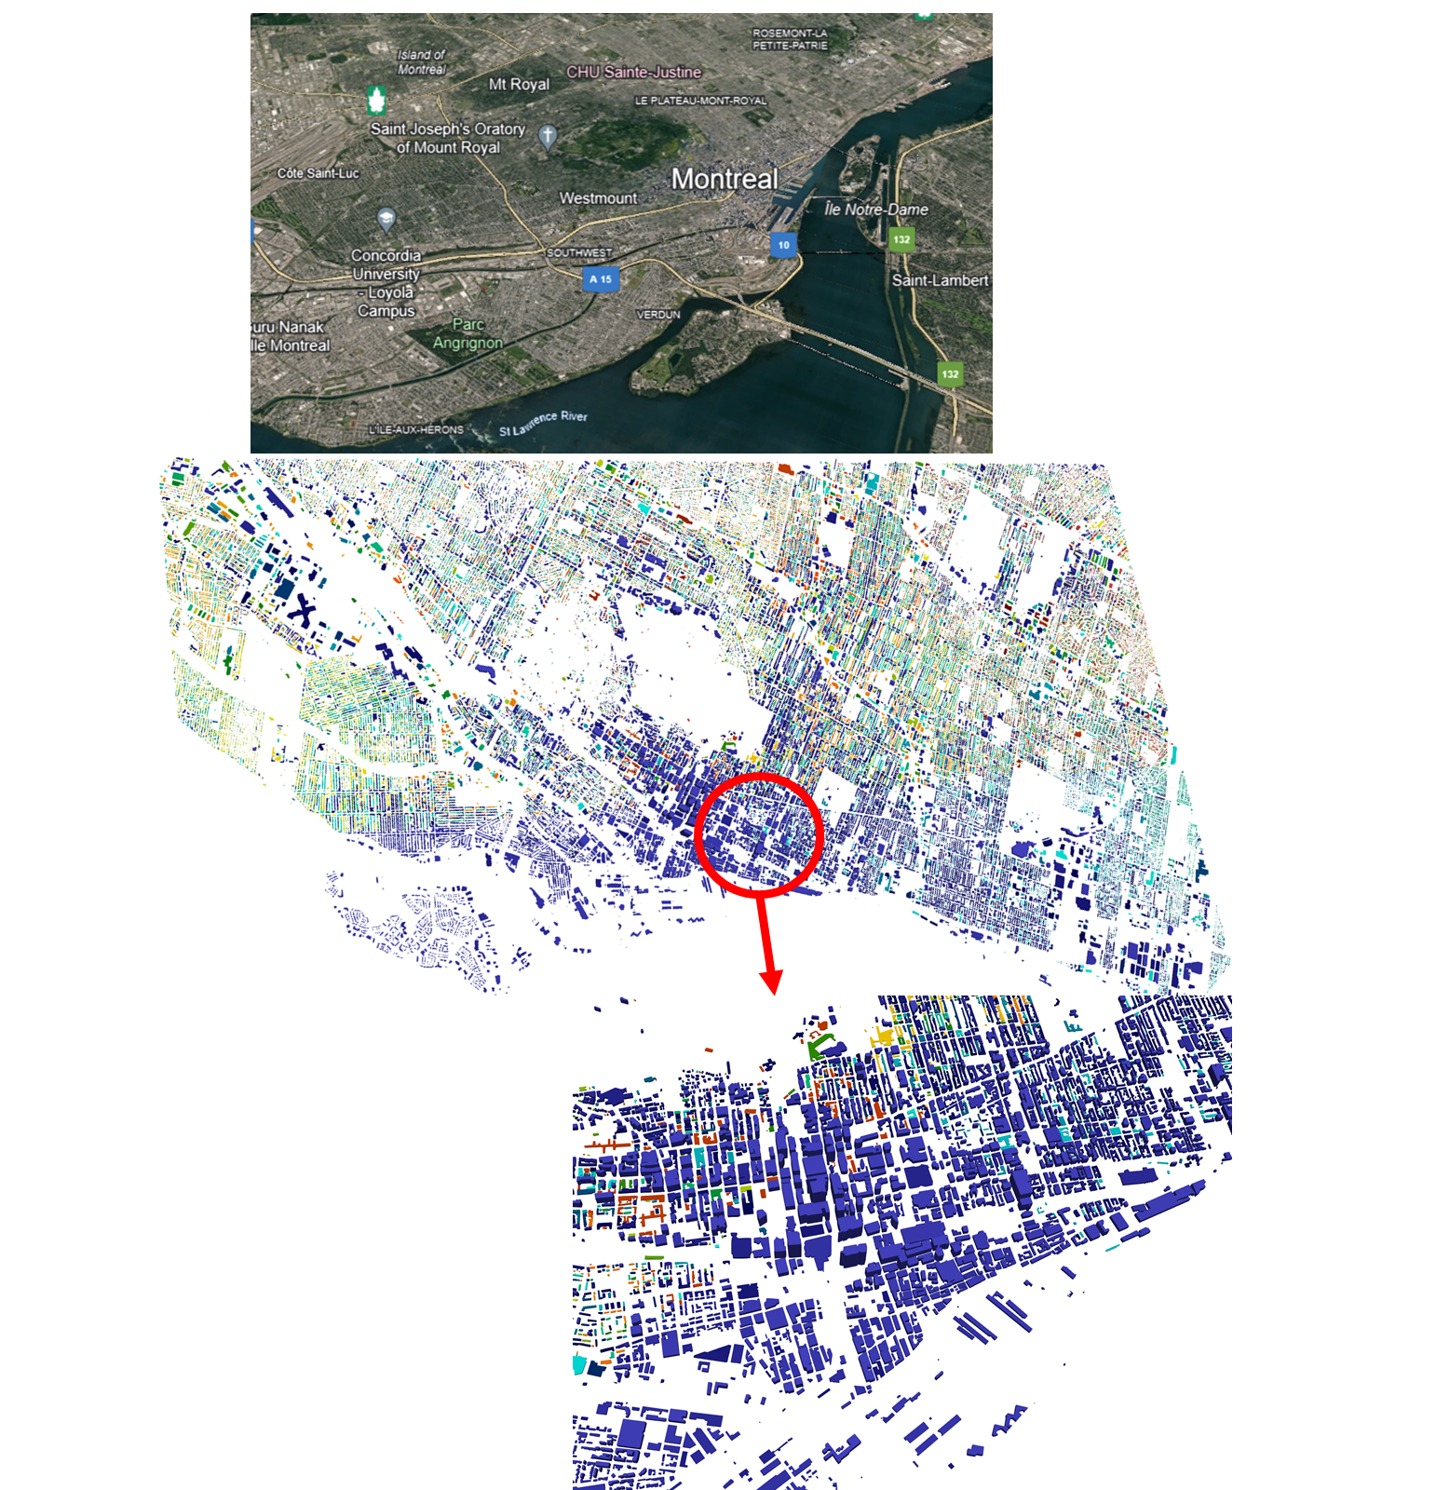
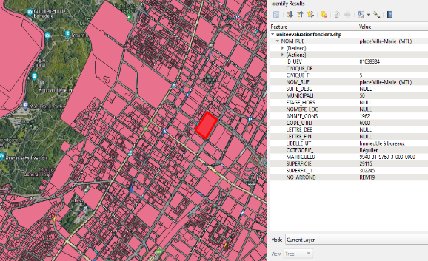
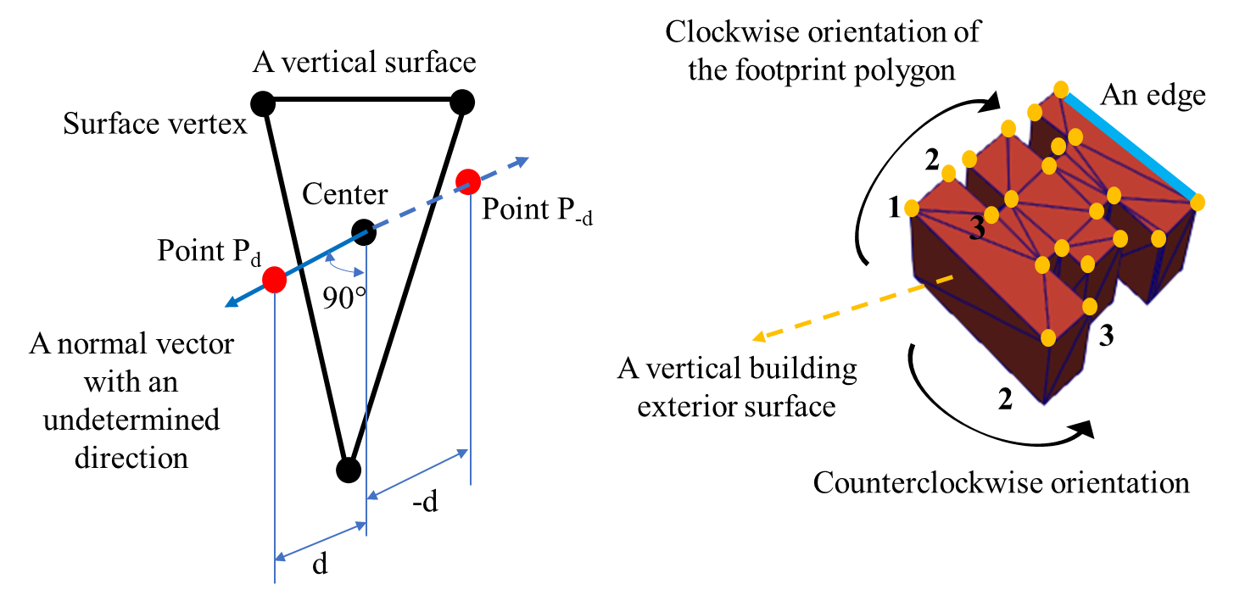
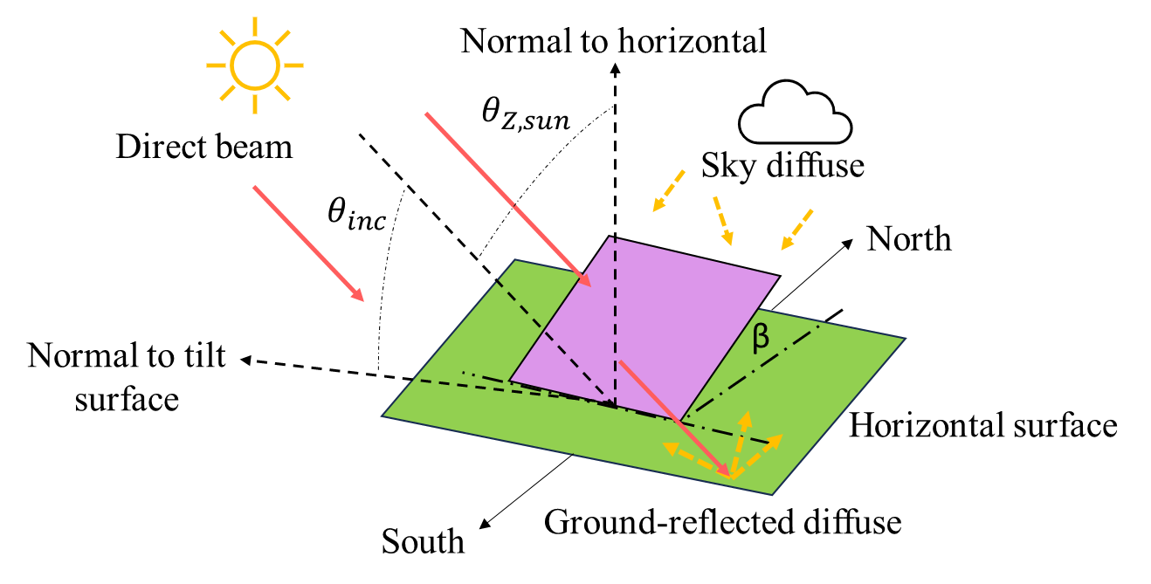
Urban Building Info (usage type, age, etc.)
3D City Geometry Processing
Surface by Surface Modeling
Detailed Solar Radiation Modeling

Slide 3

Modeling building energy self-sufficiency of using rooftop photovoltaics on an urban scale
Presented by: Saeed Rayegan, PhD Candidate
Supervisors: Prof. Leon Wang, Prof. Radu Zmeureanu
Concordia University, Department of Building Engineering

Slide 4
Building Energy Models (UBEMs): Essential Tools for Carbon Neutrality
Citywide Energy Insights: UBEMs simulate the energy use of entire building stocks, revealing high-impact areas for improvement.
Scenario-Based Planning: Enable testing of various retrofit/decarbonization strategies (e.g., rooftop PV, insulation, electrification).
Scalable and Adaptable: Applicable from neighborhood to city scales with integration of local building data and outdoor climate inputs.
Demand-Responsive Grid-Integration: Enable coordination with smart grid systems and demand-response strategies for sustainable urban energy management.
Support for Policy & Decision-Making: Provide regional-specific data for city planners and policymakers to design effective carbon reduction policies.
Monitoring Progress Toward Goals: Facilitate tracking of GHG emissions reduction over time to ensure alignment with carbon neutrality targets.

Slide 5
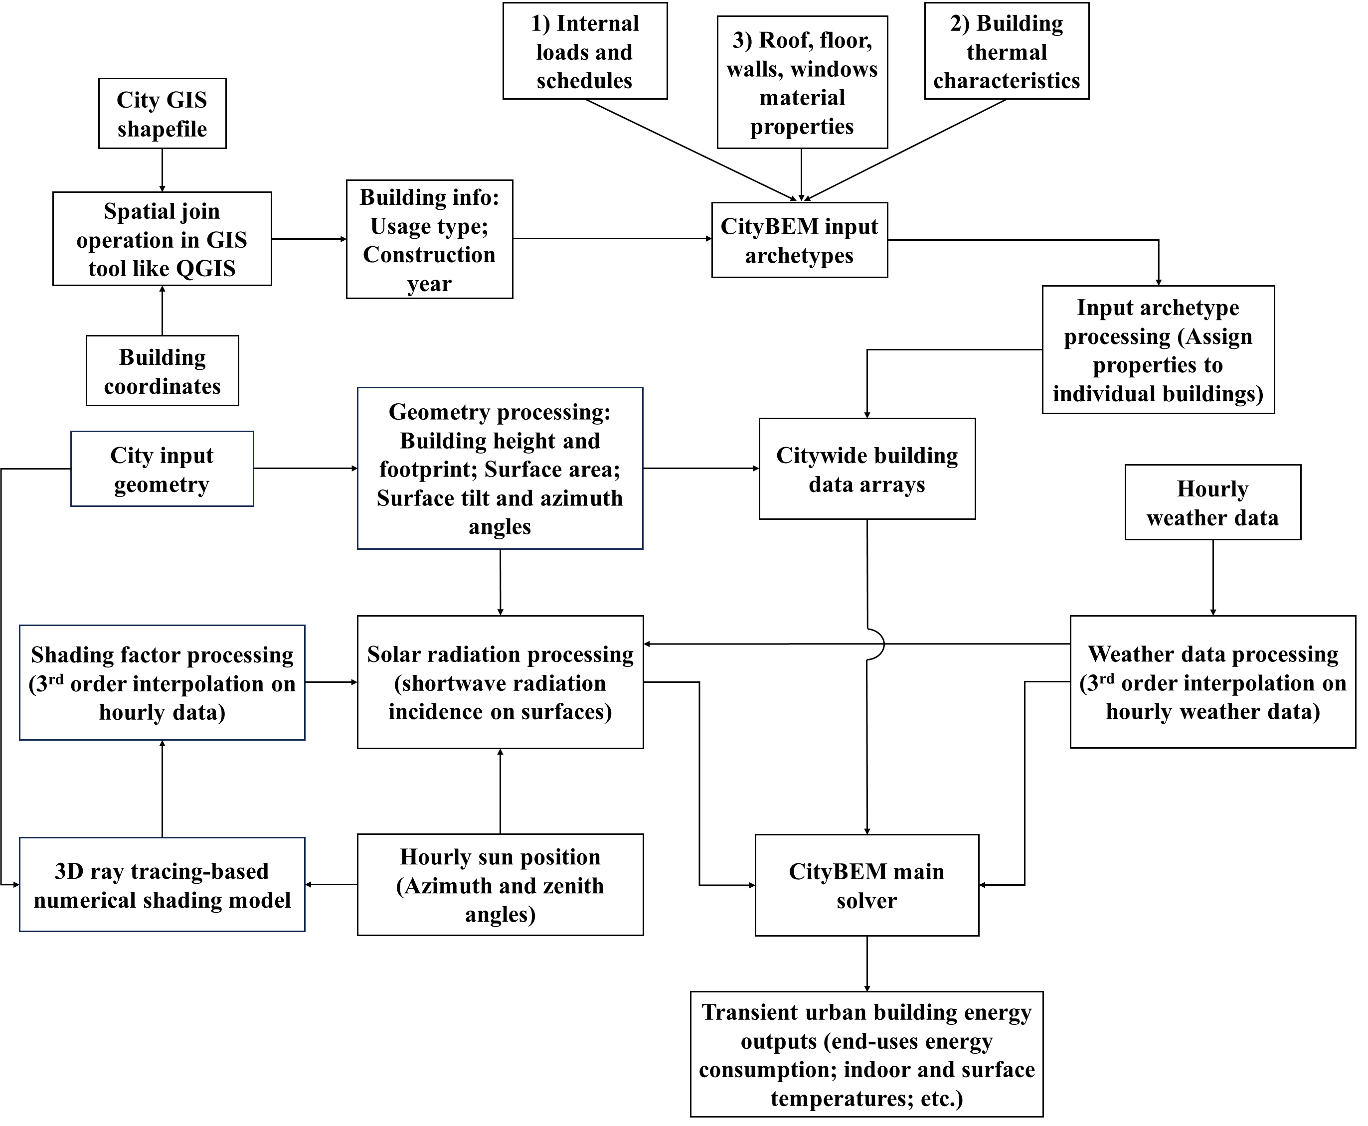
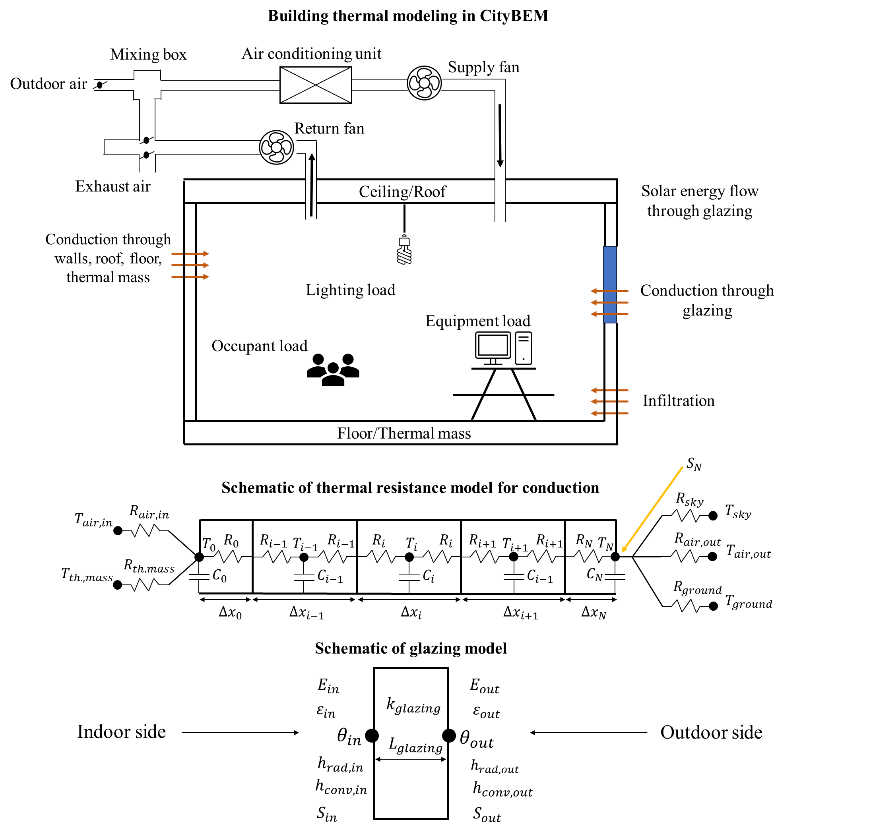
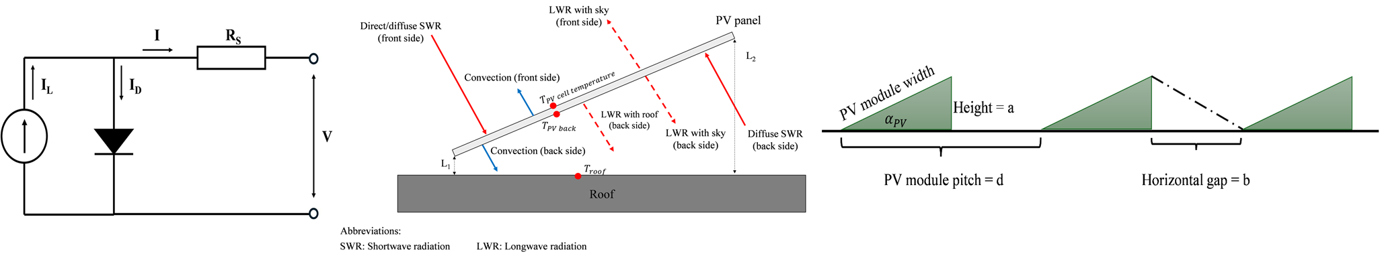
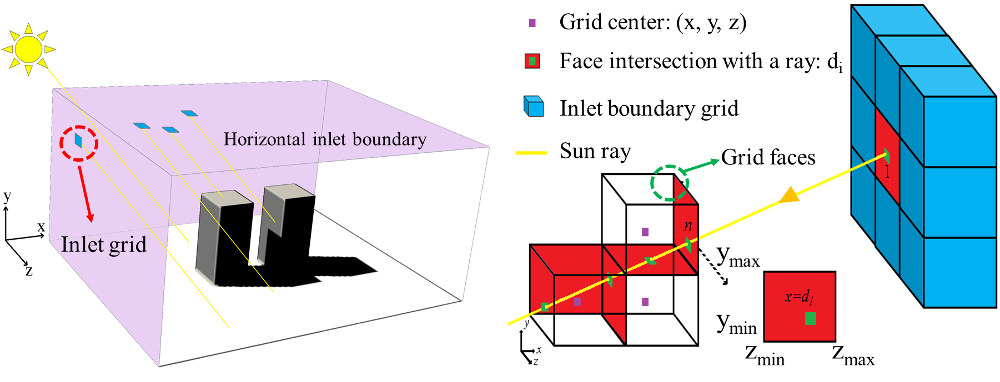
CityBEM Theoretical Foundation
Building geometry processing
Solar radiation modeling
Building energy modeling approach
Major steps in CityBEM
Rooftop PV modeling (Crystalline PVs)
Inter-building shading modeling

Slide 6
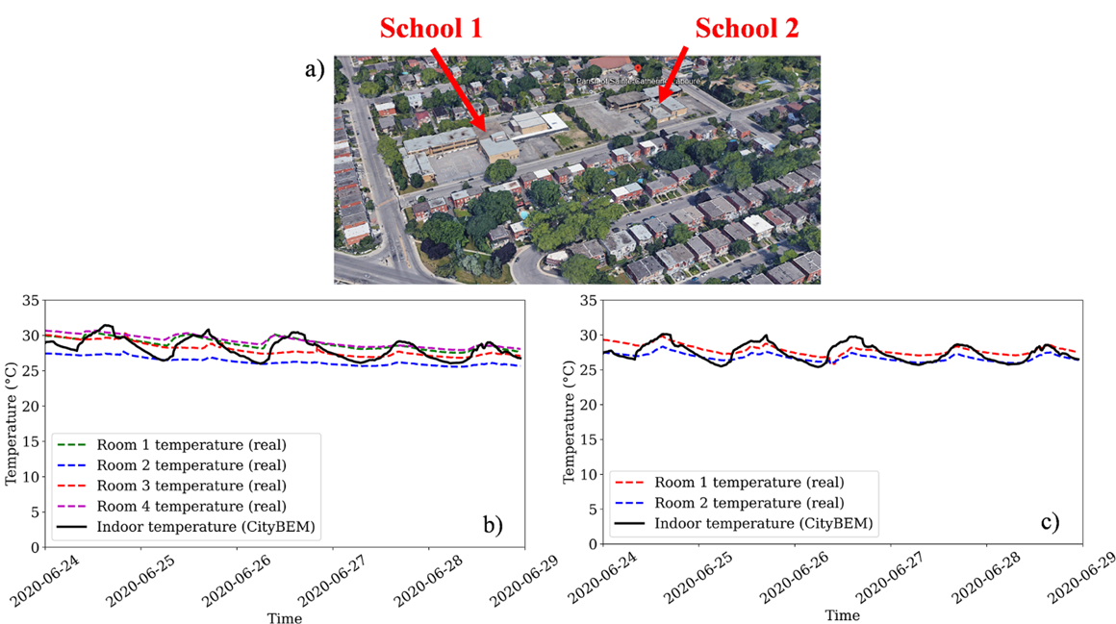
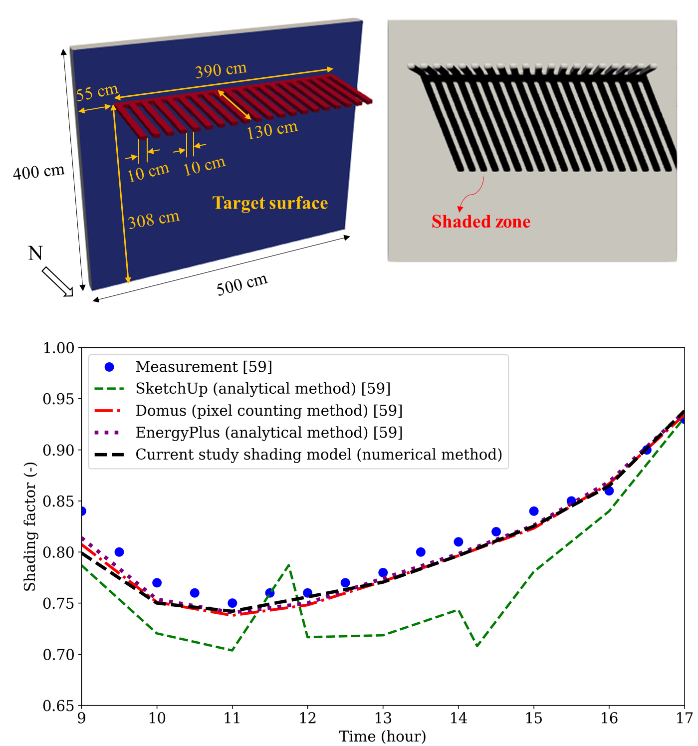
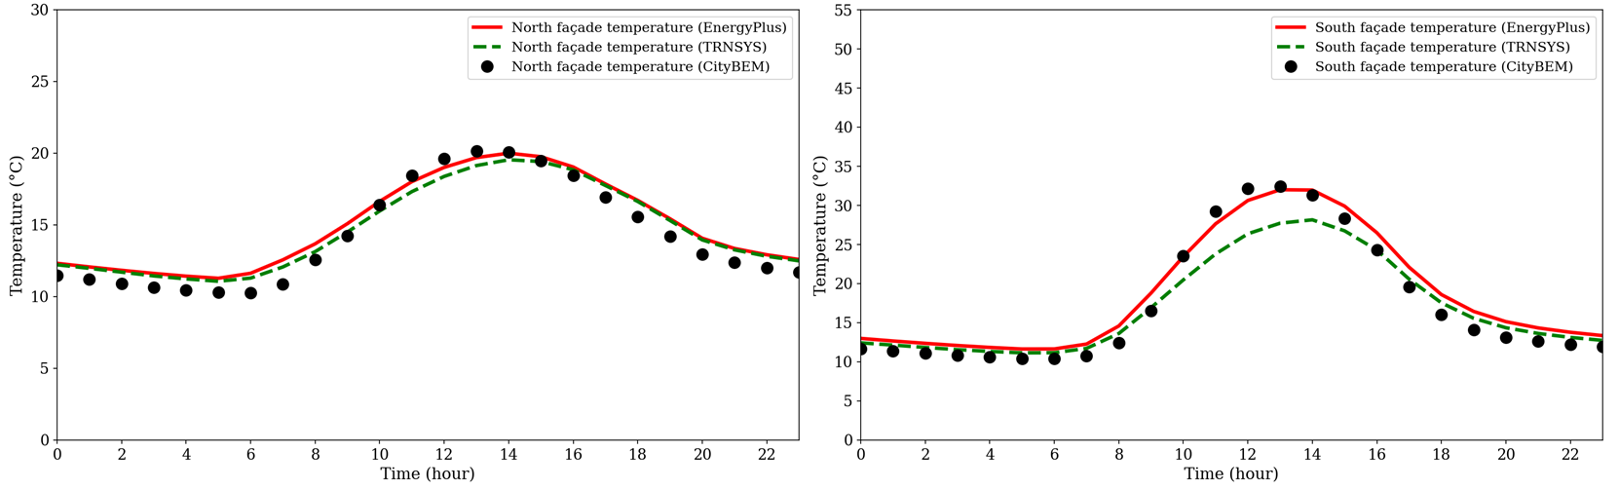
Model Validation and Verification
Average indoor air predictions
Annual EUI results
Shading model predictions
PV network output power simulation
Building surface temperature annual trend

Slide 7
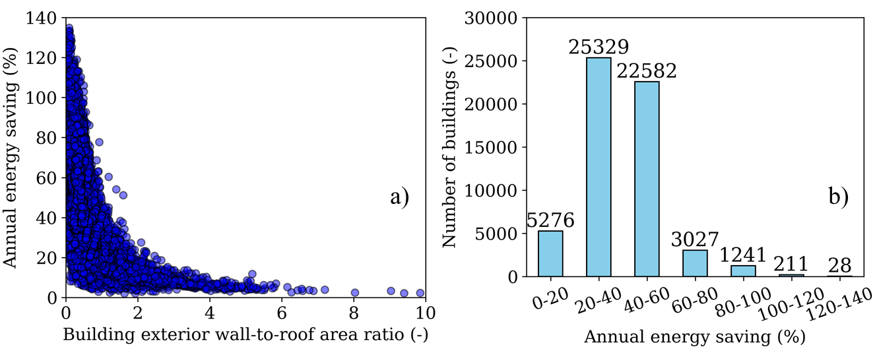
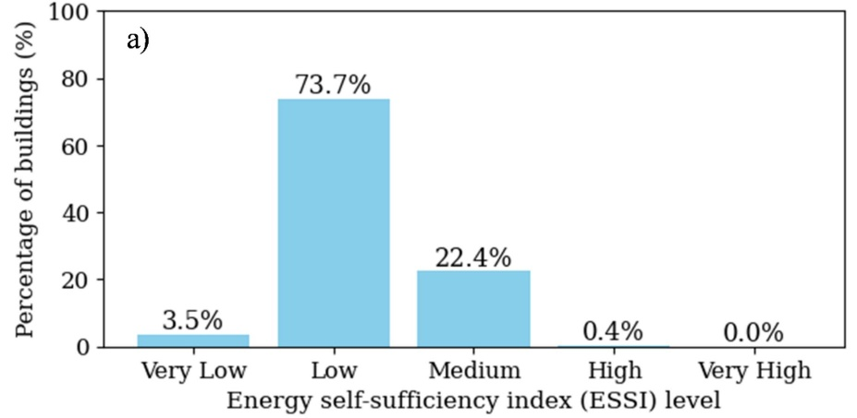
Simulation Results for the City of Montreal
Building info extraction (usage type, age, etc.)
Urban shading modeling
EUI of Montreal buildings
Labeling Montreal buildings for energy self-sufficiency level
Energy saving of PV retrofitting
3D geometry processing

